Slide 1
Getting it Wrong:
An Indictment with a Blueprint for Getting It Right
Disability Rights, Obligations and Responsibilities Before, During and After Disasters
Edition 1, May 2018
Marcie Roth, June Kailes and Melissa Marshall, J.D.
www.disasterstrategies.org

Slide 2
Learning Objectives
Understand effect of ADA noncompliance on individuals with disabilities before, during and after 2017-2018 disasters.
Understand complex circumstances contributing to disproportionate impact of disasters on people with disabilities.
Be aware of recommendations for improving preparedness and disaster resilience established by a broad coalition of disability inclusive emergency management stakeholders.

Slide 3
Partnership for Inclusive Disaster Strategies
Provides advocacy, community engagement, training, technical assistance and disaster services in support of disability community leaders,
Promotes universally designed and inclusive emergency planning, disaster response, relief, recovery and mitigation for disaster survivors with access and functional needs,
Guided by core values of equal access, inclusion and independence and a future where community resilience is achieved and sustained for all - throughout planning, alerts, evacuation, shelter, health maintenance and individual and community recovery
accessible to all,
led by active involvement of people with disabilities and fully informed by community as a whole.

Slide 4
Partnership For Inclusive Disaster Strategies
Disaster Hotline
Disability organization-led stakeholder teleconferences
Coordination of immediate lifesaving rescue assistance
Collaboration to provide health maintenance and replace lost, damaged and destroyed supplies and assistive devices
Deployment of disability experts to meet immediate needs and support local disability organization leadership
Getting It Right conferences and legislation
Digital Workshop Series

Slide 5
“Care must be taken to identify and eradicate social and institutional barriers that hinder or preclude individuals with disabilities and others in the community historically subjected to unequal treatment from full and equal enjoyment of the programs, goods, services, activities, facilities, privileges, advantages and accommodations provided.”
National Preparedness Goal

Slide 6
“Given the scope and magnitude of a catastrophic incident, waivers, exceptions, and exemptions to policy, regulations, and laws may be available in order to save and sustain life, and to protect property and the environment. However, any such waivers, exceptions, and exemptions must be consistent with laws that preserve human and civil rights and protect individuals with disabilities and others with access and functional needs…”
National Preparedness Frameworks

Slide 7
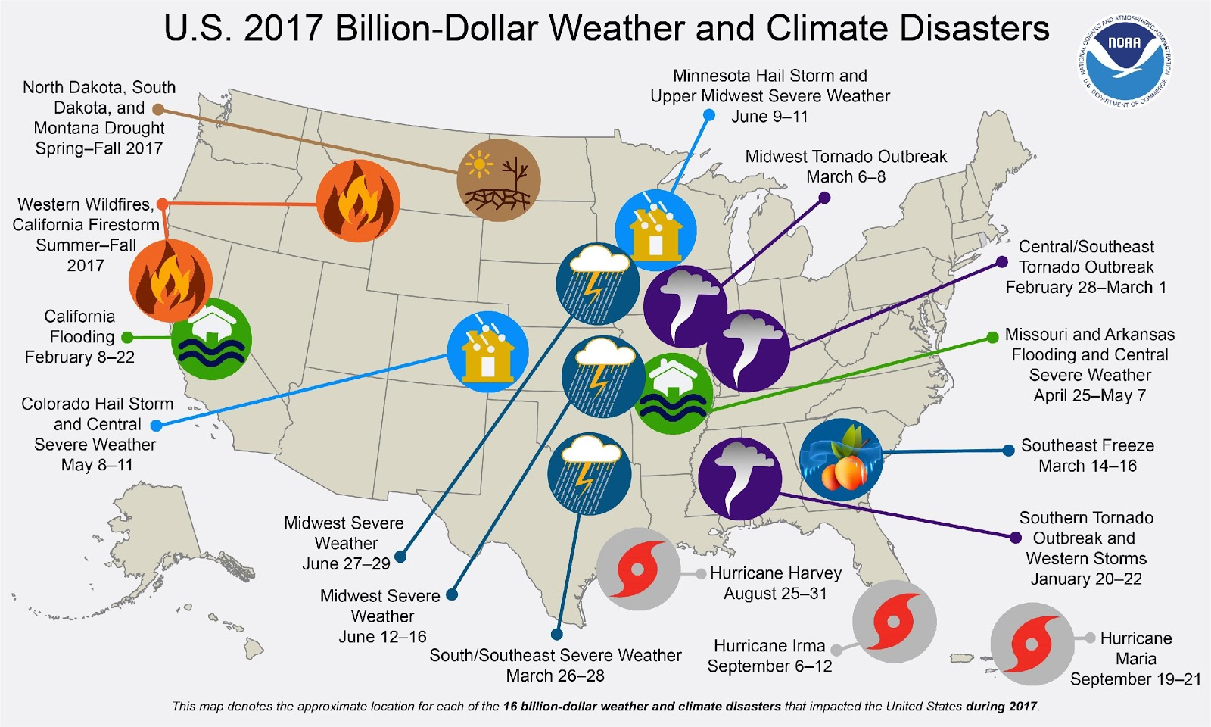
U.S. 2017 Billion-Dollar
Weather and Climate Disasters

Slide 8
Puerto Rico Disability Community Relief Network

Slide 9
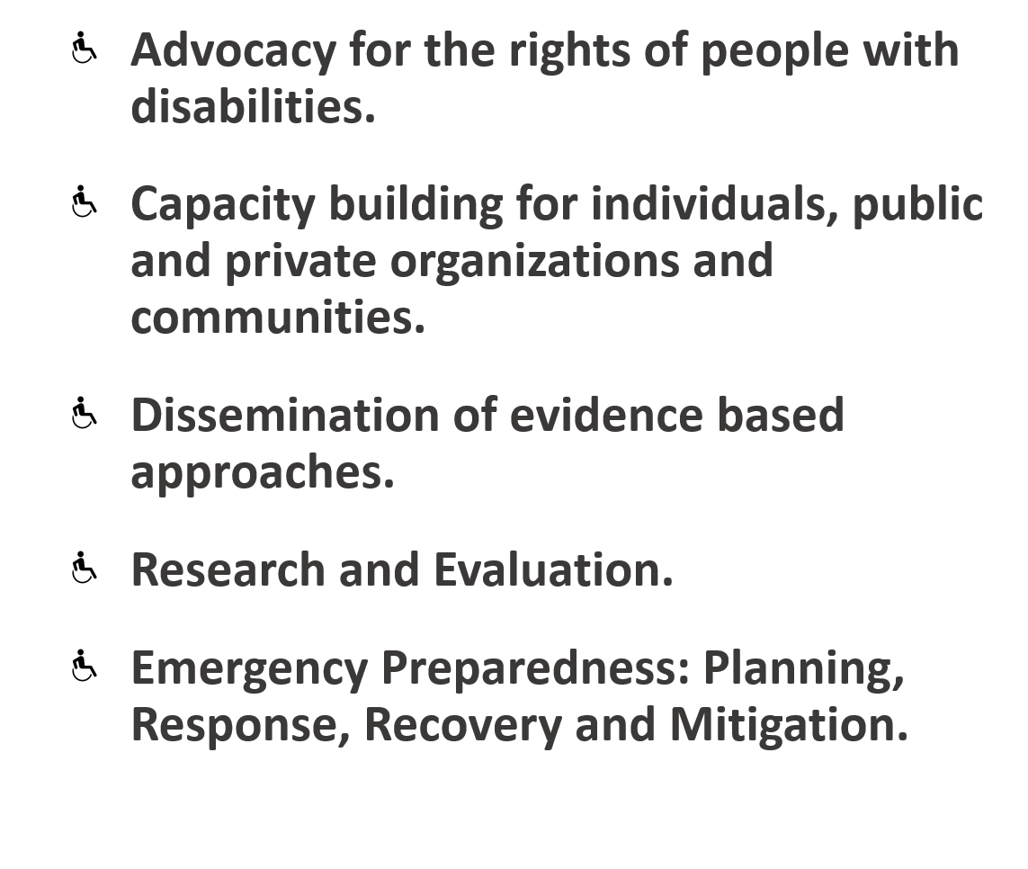
Puerto Rico Disability Community Relief Network

Slide 10
After Action Report
Background
What is an After-Action Report
Intent
Authors
Key Informants
Funder

Slide 11
After Action Report
Interviews with key informants with disabilities and allies with disability expertise in the disaster impacted areas
Review of –
Data from 3,200 Disaster Hotline calls
Information from daily stakeholder teleconferences
Transcript of Department of Homeland Security listening session
Congressional correspondence and testimony
Media reports

Slide 12
Findings
Decades of data and information from previous disasters have not been applied.

Slide 13
Findings
Lack of equal access was compounded for individuals with disabilities who are also people of color, older adults, LGBTQ people, children, women, have limited English proficiency and immigrants, especially those without documentation.

Slide 14
Findings
Continual reliance on disability organizations to act as “provider of first resort”, usually without compensation
Constant use of volunteers and donations by government to meet disability civil rights obligations

Slide 15
Findings
Disability organizations filled gaps to meet needs
Locating people
Disability accommodations
Distributing food and water, durable medical equipment and disability related supplies
Preventing and curtailing unnecessary institutionalization

Slide 16
Legal Obligations
Federal, state and local governments have significant and non waiverable obligations to children and adults with disabilities.
The After-Action Report describes federal obligations and the role of these laws when providing emergency programs and services to children and adults with disabilities before, during and after disasters.

Slide 17
Some Federal Legal Obligations to Individuals with Disabilities
Rehabilitation Act of 1973, as amended
Americans with Disabilities Act (ADA) of 1990, as amended 2008
Individuals with Disabilities Education Act (IDEA) of 1975, as amended

Slide 18
Disproportionate Health Impact
New England Journal of Medicine (May 2018) Harvard study, “Mortality in Puerto Rico after Hurricane Maria,” documented what we already knew:
Interruption of health care and disability services were primary cause of high mortality rates in months after hurricane
Most frequently reported problems:
Inability to access medications (14.4% of households)
Need for respiratory equipment requiring electricity (9.5%)

Slide 19
Examples from Maintaining Health Content
Emergency Support Function #8 - Public Health & Medical Services shortfalls:
Primary focus hospital & medical facility operations
Lack of community health maintenance assistance outside of medical facilities
Lack of support for people evacuated for health reasons
Recommended fixes:
Temporary deployment of qualified professionals
Expand community focus and resources
Expedite replacement of durable medical equipment, disability supplies and assistive devices

Slide 20
Health Plan Roles – What Worked:
Call Center protocols
Community partnerships
Member emergency plans
Posting/disseminating emergency preparedness information
Life-safety checks
Health information exchange
Preventing and diverting inappropriate admissions
Expediting replacement of equipment and supplies
Messaging
Member tracking

Slide 21
Health Plan Roles – Recommended Fixes:
States should incorporate emergency roles & responsibilities into health plans contracts.
Create health plan industry-wide emergency service, guidance, training, technical support, and regulatory standards such as the CMS Emergency Preparedness Rule for facilities and suppliers.
Integrate specific emergency performance clauses into vendor and contractor agreements.
Establish & test agreements for emergency supply delivery and evacuation services.
Connect with community partnerships for planning,
exercises, drills, response, and recovery activities.

Slide 22
Registry After Action Report Content – Another Example
50 minutes workshop from Getting It Right Conference
Search for:
The Inconvenient Truth About Registries, Power, Alerts and Evacuation
or
Go to: https://www.youtube.com/watch?v=y1SpBhpUUbk

Slide 23
Failure to Provide Equally Effective Communication
Lack of equally effective communication in shelter for people who are Deaf
Example: Individual walking around George R. Brown Convention Center with a sign with the word “Deaf” on it
Recommendations
Department of Justice and other Federal civil rights offices must enforce compliance with effective communication obligations.
Training and technical assistance must be provided to local emergency management.

Slide 24
FEMA registration process inadequate to provide equal access and reasonable accommodations
Inability to indicate that you have a disability when registering for FEMA
Example: Disaster survivor with a spinal cord injury institutionalized due to pressure sores because he was forced to share a TSA bed because he could not identify his need for accommodation on application
Recommendations
Redesign and publish FEMA disaster assistance application
Engage knowledgeable disability community leaders

Slide 25
Education
Students with disabilities are denied a Free and Appropriate Public Education
Example: Student with autism had no transportation to new school and no transition support
Recommendations
IEPs and 504 plans must be stored in the cloud for availability during and after disasters.
Parents should be given digitized versions of IEPs or 504 Plans on flash drives each time the IEP or 504 Plan is updated.
IEPs and 504 Plans must include emergency contingencies

Slide 26
Additional Equal Access Failures
Notification
Evacuation
Sheltering
Disaster Recovery Centers
Food and Water Distribution
Distribution of Goods
Home Inspection
Housing
Appealing Denials

Slide 27
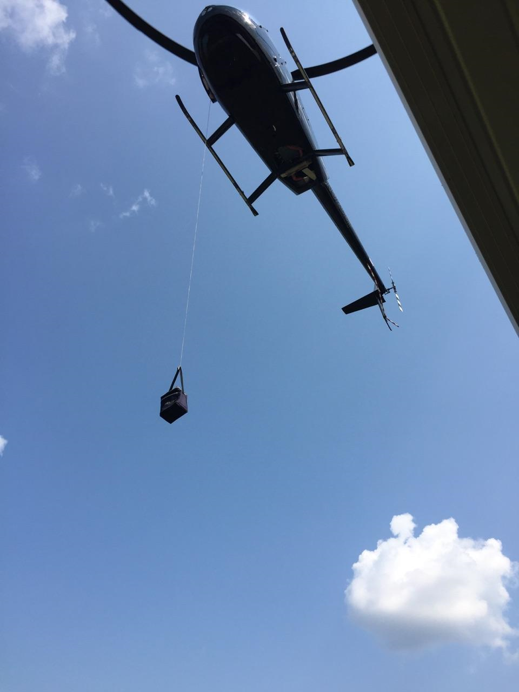
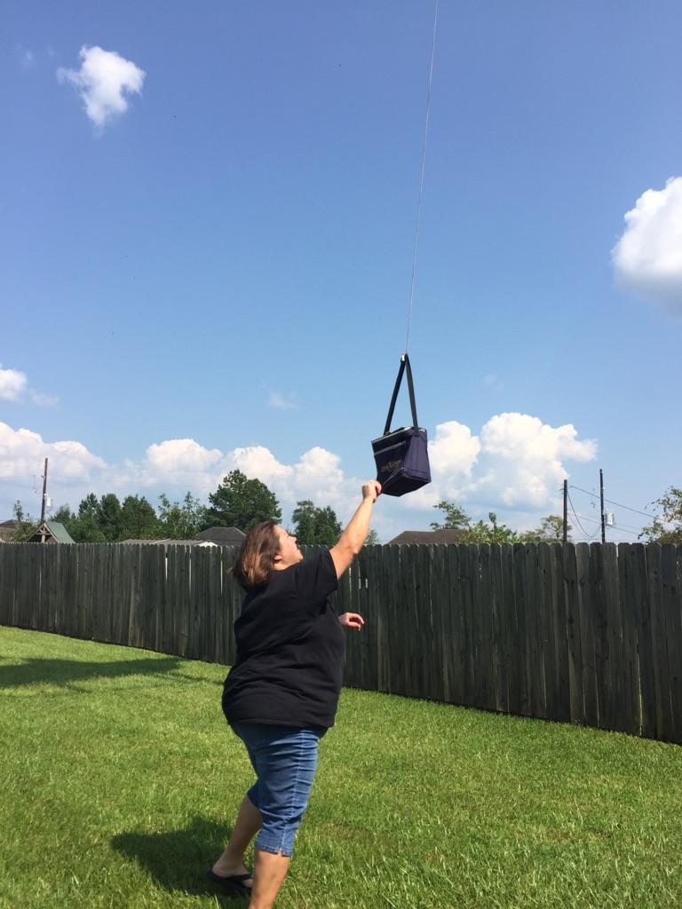
Disaster Response
Hurricane Harvey

Slide 28
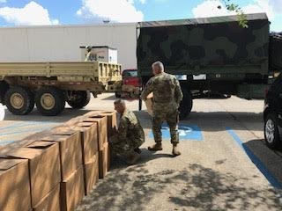
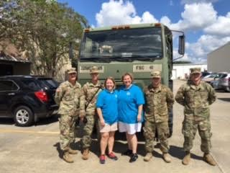
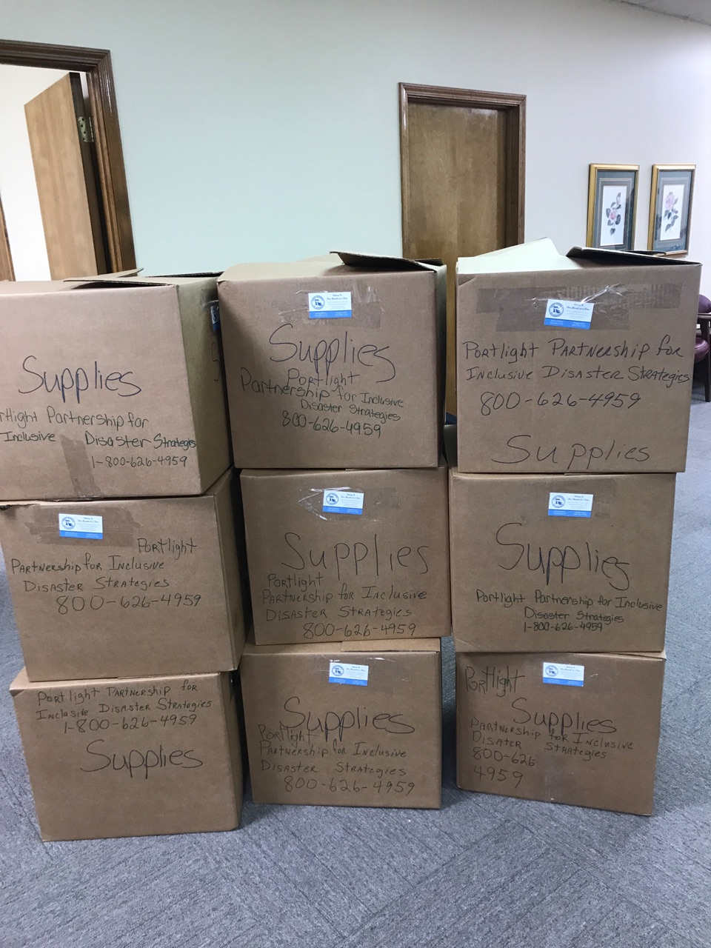
Disaster Response - Hurricane Irma
Partnership, National Guard, Trach Mamas

Slide 29
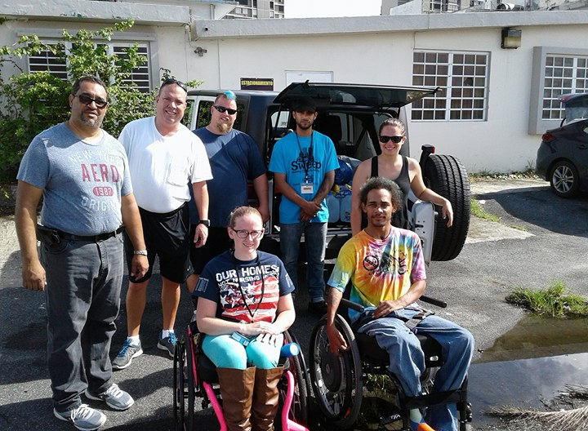
Disaster Response
Disaster Response - Hurricane Maria
https://www.facebook.com/rootedinrights/videos/1530404470381837/

Slide 31
www.disasterstrategies.org

